Slide 1
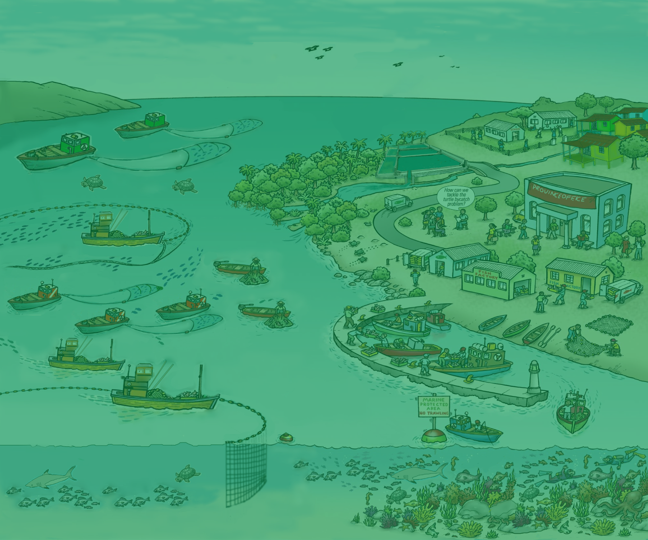
6. EAFM plans the link between policy and action
Version 1

Slide 2
Activity: National Laws and Policies
Identify national laws and policies for fisheries, environment and habitat management
Do these national laws and policies align with the principles of EAFM and international agreements
Do these national laws and policies support or prevent EAFM
Do the national laws and policies support or conflict with each other
2
Notes:
All countries have a legislative framework and policies. Do these prevent your country from implementing EAFM?

Slide 3
Plans are needed to implement policies
Why plan?
Promote resource use efficiency
- provides more certainty on the roles and responsibilities of the different players
Facilitates resources (people and money) mobilization
Encourages participation and ownership in the management process
Notes:
We plan to implement policies. Policies by themselves are very difficult to implement. They need supportive planning.
Planning involves setting objectives and agreeing on actions to meet those objectives. (coming later)
Promote resource use efficiency. Planning provides more certainty on the roles and responsibilities of the different players.
Facilitates resources (people and money) mobilization
Encourages participation and ownership in the management process.

Slide 4
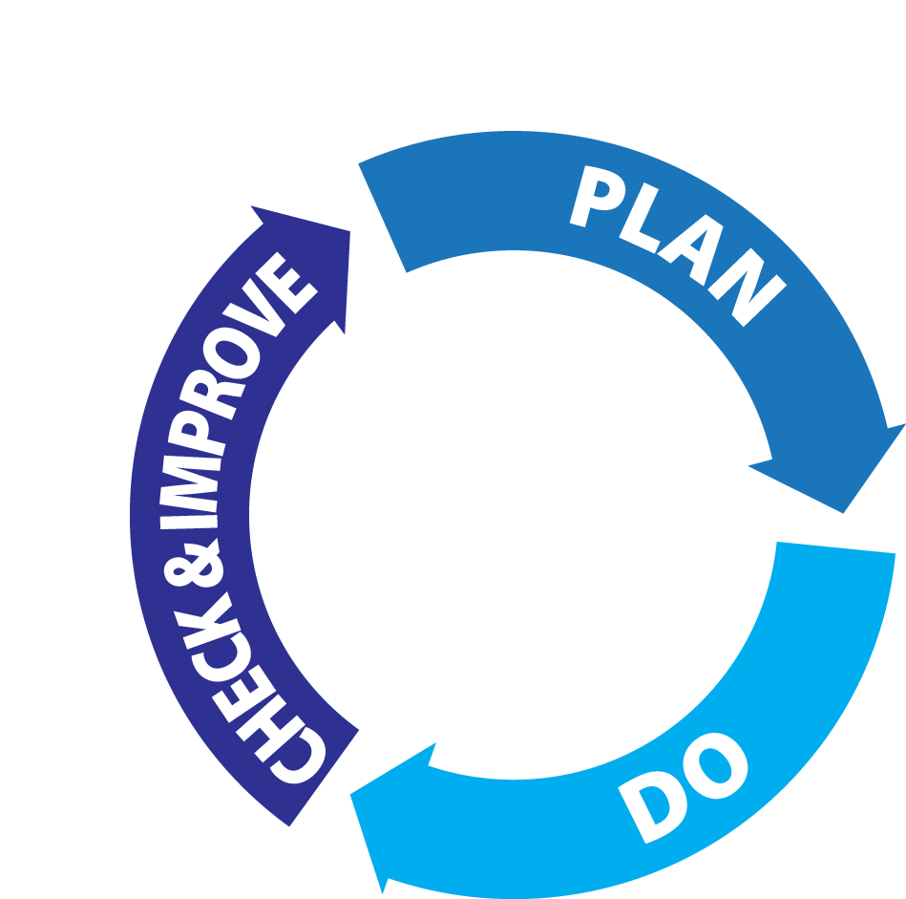
Management involves:
Notes:
This is first time we introduce the Management cycle (the EAFM process cycle is based on this). This can be applied to managing anything e.g. a business, a district office, or a project. Be sure not to call them steps – these are the general phases in which the steps come under.
Stress that this cycle is repeated many times as we learn by doing.
Refer participants to Module 6, section 2 and go through what each phase involves- i.e. management’s role in supporting each phase. Check & improve is the adaptive management part of the cycle.

Slide 5
EAFM PLAN:
linking legislation/policy to action
Example
Sustainably manage fisheries
Legislation/policy
Limit fishing effort in the trawl fishery
EAFM PLAN
Control number of fishing boats/gears
Management actions
Notes:
EAFM encourages good planning, and implementing actions linked logically to these plans and higher level policies. It emphasises that having an EAFM plan will help link the high-level policy objectives, often derived from International Conventions, Treaties, and similar instruments, as well as national legislation and policies that already exist in most countries with actual management actions on the ground that will implement those policies.
Legislation and policies say what needs to be achieved. Plans (linked to rules and regulations) say how they will be achieved.
One example is given – one fisheries
Fisheries legislation (e.g. Fisheries Act ) and policies (e.g. 5-year National social and economic development plan) will often have an aim of “Sustainably management fisheries”. However, unless supported by practical plans that sets out management actions these aim will never be achieved. The plan specifies the need to limit the fishing effort in the trawl fishery and the management action of controlling the number of boats and fishing gear
Another ecological example:
Environmental legislation (e.g. Environment Protection Act) and policies (e.g. Marine conservation policy) often state have an aim of a “Healthy Environment”. To achieve this aim in a fisheries context, a plan is required that specifies the need to protect the fish habitat and a management action of closing a selected area through a marine protected area (MPA)

Slide 6
EAFM PLAN:
linking legislation/policy to action
Example
Sustainably manage fisheries
Legislation/policy
Limit fishing effort in the trawl fishery
EAFM PLAN
Control number of fishing boats/gears
Management actions
Notes:
Without a plan the policy will not be implemented.

Slide 7
Good planning
Provides a clear sense of direction
Promotes transparency
Considers alternative courses of action
Is based on the best information available (uncertainty reduces through time)
Notes:
Some characteristics of good planning are that it:
Provides a clear sense of direction
Promotes transparency
Considers alternative courses of action
Is based on the best information available (uncertainty reduces through time).

Slide 8
Outputs from planning
Often a set of nested plans:
National five-year plan
Agency Strategic plan
EAFM plan
Work plans
Notes:
There are often a set of nested plans starting from the higher level long-term national plan. Under this there may be an agency strategic plan. EAFM Plans and an implementation Work plan to implement it lie under the national agency plan. Overall policies and visions must align.
Draw nested example/ diagram on flipchart to ensure concept of ‘nested’ is clear. So: their EAFM plan has to be nested within their agency and country strategies (which we elicited at start of this session).

Slide 9
Key messages
High level principles and policies can not be implemented as they stand
EAFM plans provide a link between higher level policy (e.g. National fisheries policy) and management actions on the ground
In this way, management actions in EAFM will promote the implementation of the high level policies over time
Notes:
Self explanatory

